Slide 1

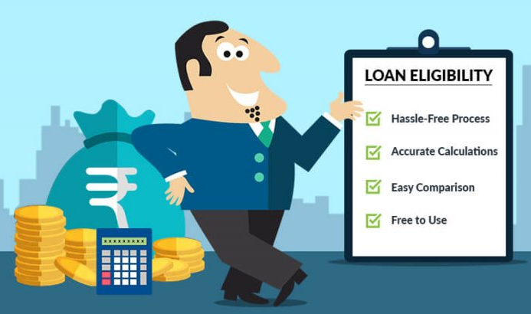
LOAN ELIGIBILITY PREDICTOR

Slide 2
Introduction
Loans are one of the core business of banks as a lot of profit is gained through loans interest. Now usually loan eligibility is decided after a long and intensive process of verification of documents and validation of set of criteria's which takes up huge amount of time.
This time consuming process can be avoided by developing a system that can predict whether a person can be eligible for loan based on information filled in loan application form which has all criteria for validating the eligibility.

Slide 3
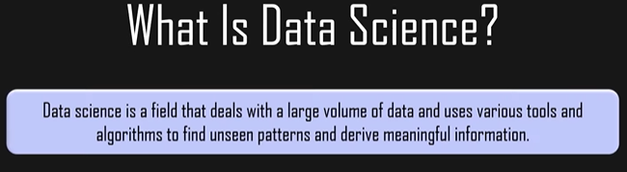
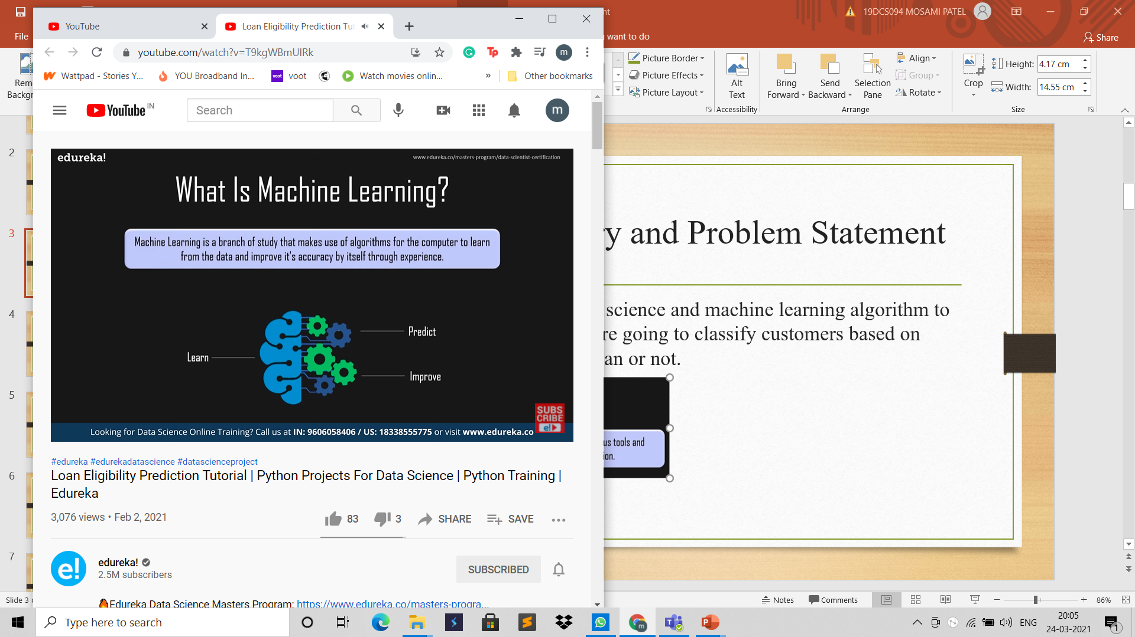
Background Theory and Problem Statement
Here we’ll use concept of data science and machine learning algorithm to develop our project where we’re going to classify customers based on whether they are eligible for loan or not.

Slide 4
Background Theory and Problem Statement
There are various types of machine learning:
Supervised learning: In this type you use labelled data. It means the data is already tagged with correct answer.
Unsupervised learning: In this type deals with unlabelled data that is here an answer is not provided for the machine to learn from. Here the model works on its own to discover patterns that were previously not discovered.
Reinforcement learning: In this type there is no answer but reinforce agent decides how to perform a given task through a sequence of feedbacks based on actions performed.
The machine learning that we’ll be using for project is supervised learning.

Slide 5
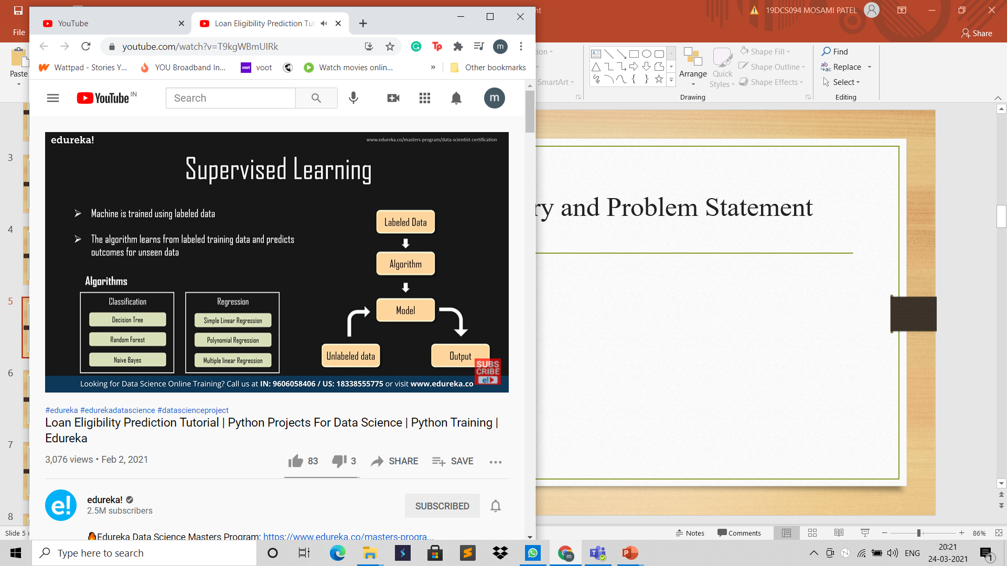
Background Theory and Problem Statement

Slide 6
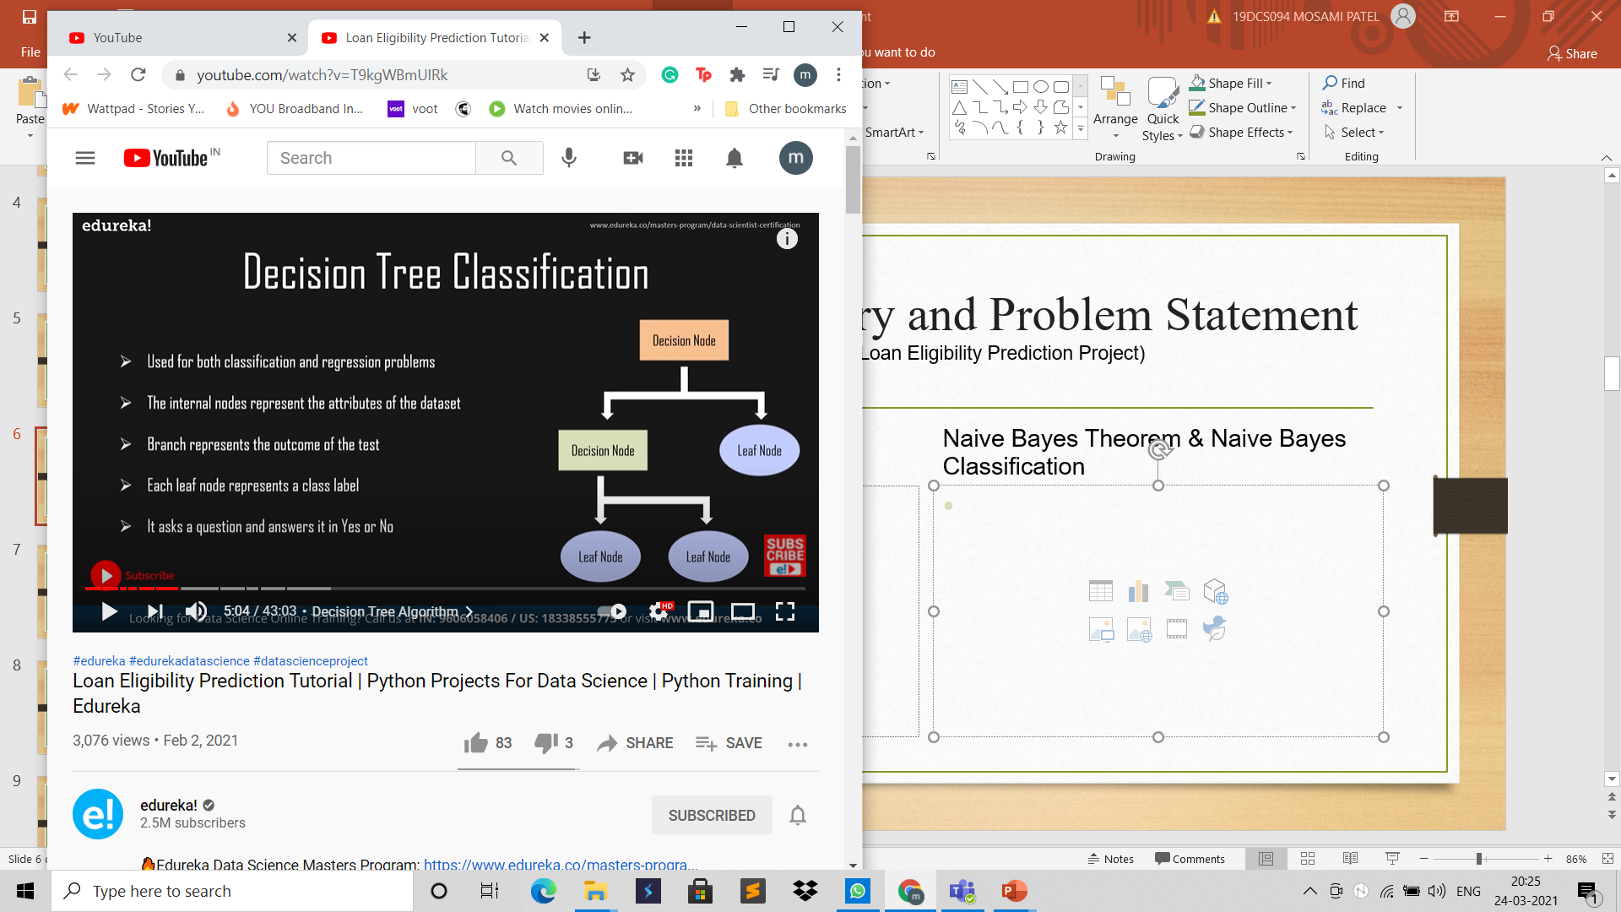
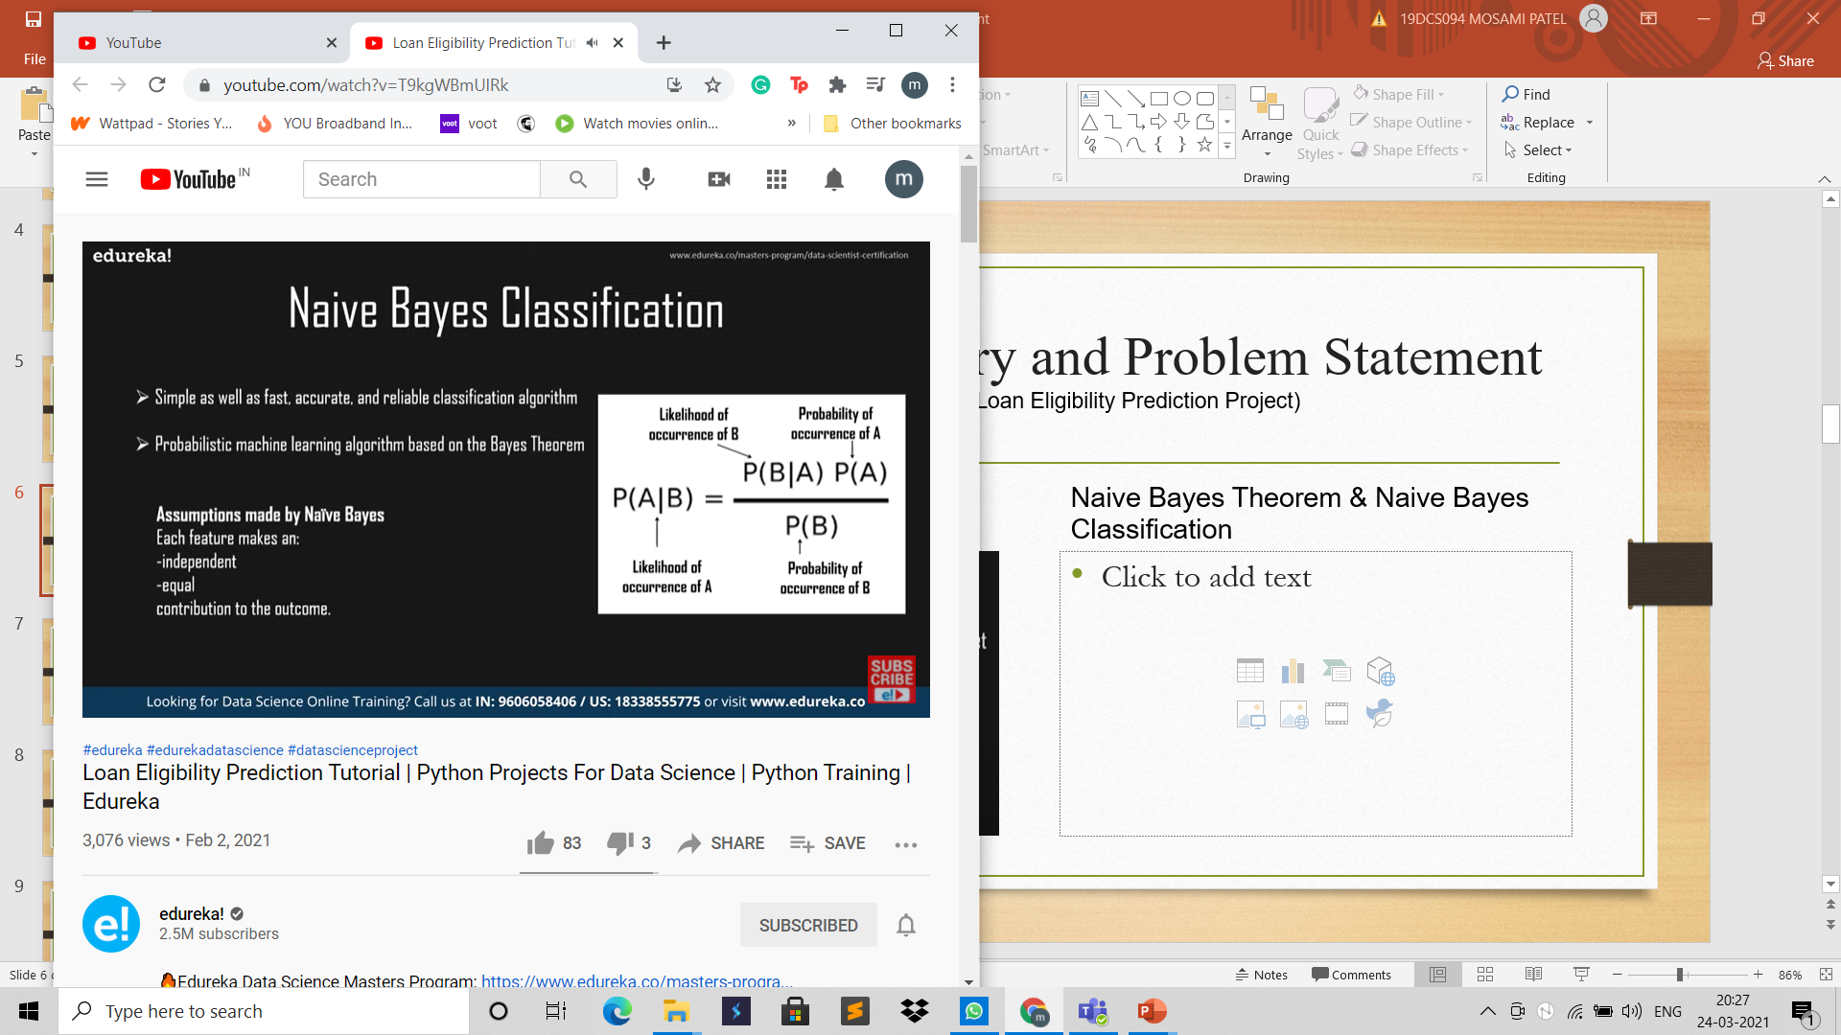
Background Theory and Problem Statement (Algorithms For Loan Eligibility Prediction Project)
Naive Bayes Theorem & Naive Bayes Classification
Decision Tree Algorithm

Slide 7
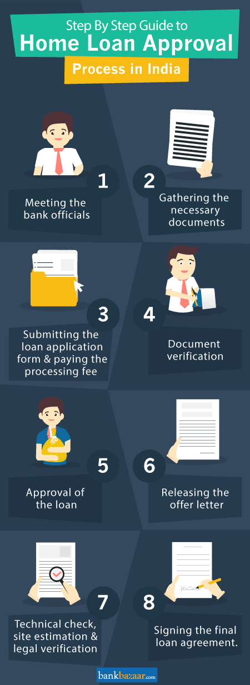
Current System and its limitations
Getting a loan is time consuming and often requires a lot of patience. From incomplete information to missing documents, your loan might be out on hold for numerous reasons.
Though banks offer pre-approved loans and other features like applying for a loan through net banking, none of these offers eliminate the need for document submission, verification, and other such requirements that are mandatory.
This time consuming process can be avoided by developing a system that can predict whether a person can be eligible for loan based on information filled in loan application form which has all criteria for validating the eligibility.

Slide 8
Proposed System and Scope of the System.
The proposed model focuses on predicting the credibility of customers for loan repayment by analyzing their behavior.
The input to the model is the customer behavior collected.
On the output from the classifier, decision on whether to approve or reject the customer request can be made.
Using different data analytics tools loan prediction and there severity can be forecasted. In this process it is required to train the data using different algorithms and then compare user data with trained data to predict the nature of loan.

Slide 9
Proposed System and Scope of the System.
There have been numbers cases of computer glitches, errors in content and most important weight of features is fixed in automated prediction system, So in the near future this software could be made more secure, reliable and dynamic weight adjustment .
In near future this module of prediction can be integrate with the module of automated processing system.
The system is trained on old training dataset in future software can be made such that new testing date should also take part in training data after some fix time.

Slide 10
REQUIRMENT GATHERING TECHNIQUE USED
Libraries Used in the Project
Pandas: It stands for python data analysis library. It can be used for importing data and creating a python object with rows and columns and can also be used to write data into a file. Using various commands pandas can be used for viewing, selecting, filtering and analyzing data as well.
NumPy: It consists of multidimensional array as well as matrix data structures. It can be used to perform mathematical operation on array such as statistical and algebraic operations.
Matplotlib: it is an amazing visualization library. It can be used to create interactive graphs and charts.
Scikit learn: It is a very beneficial library as it can provide you with a large number of useful tools which can make implementing machine learning in python a lot easier. It provides you the ability to use many supervised and unsupervised algorithms just by importing those algorithms using the library.

Slide 11


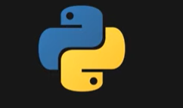
Hardware and Software Requirements
HARDWARE
Pc or laptop
minimum requirement:-
i3 processor.
Ram of 4gb
Proper steady internet connection
SOFTWARE
Anaconda (python 3)
[ jupyter notebook]

Slide 12
CONCLUSION
This application can help banks in predicting the future of loan and its status and depends on that they can take action in initial days of loan.
Using this methodology bank can easily identify the required information from huge amount of data sets and helps in successful loan prediction to reduce the number of bad loan problems.
Data Mining techniques are very useful to the banking sector for better targeting and acquiring new customers, most valuable customer retention, automatic credit approval which is used for fraud prevention, fraud detection in real time, providing segment based products, analysis of the customers, transaction patterns over time for better retention and relationship, risk management and marketing.

Slide 13
ROLES AND REPONSIBILITY OF TEAM MEMBERS
19DCS092 MANTHAN
Presentation slides (3,4,5,6,10,11)
Project part (combined effort)
19DCS094 MOSAMI
Presentation slides (2,7,8,9,12)
Project part (combined effort)

Slide 14
References
https://www.anaconda.com/products/individual
https://www.youtube.com/watch?v=T9kgWBmUIRk
https://www.kaggle.com/
https://towardsdatascience.com/predict-loan-eligibility-using-machine-learning-models-7a14ef904057

Slide 15
THANK YOU!
19DCS092 MANTHAN PATEL
19DCS094 MOSAMI PATEL

